Slide 1
Introduction to Management and Organizations
Chapter
1
1–<number>

Slide 2
Contents
1.1 Who Are Managers?
  Explain how managers differ from non-managerial employees.
  Describe how to classify managers in organizations.
1.2 What Is Management?
  • Define management.
  • Explain why efficiency and effectiveness are important to management.
1–<number>

Slide 3
Contents
1.3 What Do Managers Do?
  Describe the four functions of management.
  Explain Mintzberg’s managerial roles.
  Describe Katz’s three essential managerial skills and how the importance of these skills changes depending on managerial level.
  Discuss the changes that are impacting manager’s jobs.
  Explain why customer service and innovation are important to the manager’s job
1–<number>

Slide 4
Contents
1.4 What Is An Organization?
  Explain the characteristics of an organization.
  Describe how today’s organizations are structured.
1.5 Why Study Management?
  Discuss why it’s important to understand management.
  Explain the universality of management concept.
  Describe the rewards and challenges of being a manager.
1–<number>

Slide 5

Who Are Managers?
Manager
  Someone who coordinates and oversees the work of other people so that organizational goals can be accomplished.
1–<number>

Slide 6
Classifying Managers in organization
First-line Managers
  Individuals who manage the work of non-managerial employees.
Middle Managers
  Individuals who manage the work of first-line managers.
Top Managers
  Individuals who are responsible for making organization-wide decisions and establishing plans and goals that affect the entire organization.
1–<number>

Slide 7
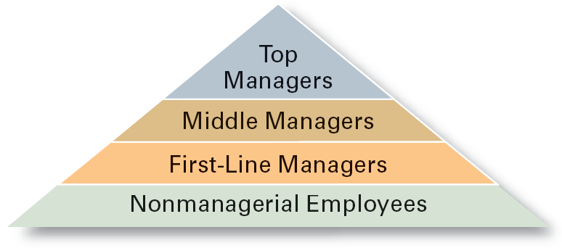
Managerial Levels
1–<number>

Slide 8
What Is Management?
Management involves coordinating and overseeing the work activities of others so that their activities are completed efficiently and effectively.
1–<number>

Slide 9

Management concerns
Managerial Concerns
  Efficiency
    “Doing things right”
      Getting the most output for the least inputs
  Effectiveness
    “Doing the right things”
      Attaining organizational goals
1–<number>

Slide 10
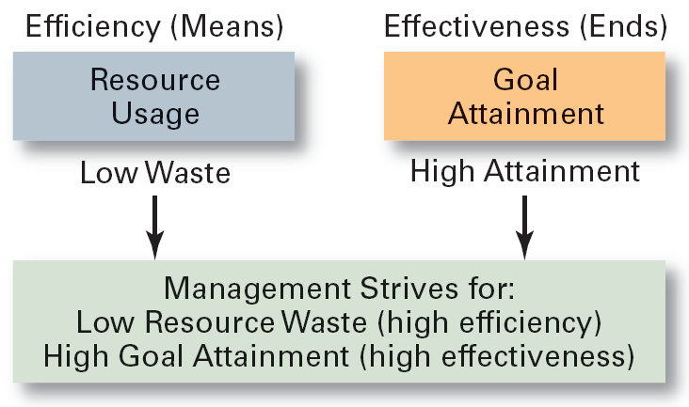
1–1 Effectiveness and Efficiency in
Management
1–<number>

Slide 11
What Managers Do?
Three Approaches to Defining What Managers Do.
  Functions they perform.
  Roles they play.
  Skills they need.
1–<number>

Slide 12
What Managers 3 functions
Functions Manager’s Perform
  Planning
    Defining goals, establishing strategies to achieve goals, developing plans to integrate and coordinate activities.
  Organizing
    Arranging and structuring work to accomplish organizational goals.
  Leading
    Working with and through people to accomplish goals.
  Controlling
    Monitoring, comparing, and correcting work.
1–<number>

Slide 13
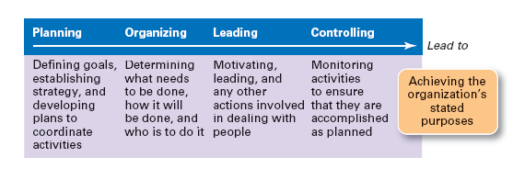
1–2 Management Functions
1–<number>

Slide 14
What Managers Do?
Roles Manager’s Play
  Roles are specific actions or behaviors expected of a manager.
  Mintzberg identified 10 roles grouped around interpersonal relationships, the transfer of information, and decision making.
1–<number>

Slide 15

What Managers Do?
Management Roles (Mintzberg)
  Interpersonal roles
    Figurehead, leader,
  Informational roles
    Monitor, disseminator, spokesperson
  Decisional roles
    Entrepreneur, disturbance handler, resource allocator.
1–<number>

Slide 16
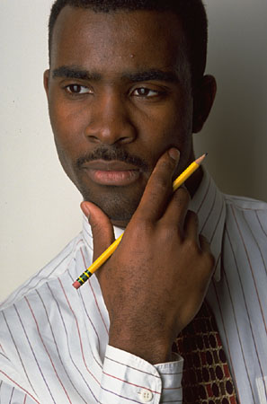
What Managers Do (Mintzberg)
Actions
  thoughtful thinking
  practical doing
1–<number>

Slide 17
1.3 Mintzberg’s Managerial Roles
Interpersonal Roles
  • Figurehead
  • Leader
Interpersonal Roles
  • Monitor
  • Spokesperson
Decisional Roles
  • Entrepreneur
  • Disturbance handler
  • Resource allocator
1–<number>

Slide 18
What Managers Do?
Skills Managers Need
  Technical skills
    Knowledge and proficiency in a specific field
  Human skills
    The ability to work well with other people
  Conceptual skills
    The ability to think and conceptualize about abstract and complex situations concerning the organization
1–<number>

Slide 19
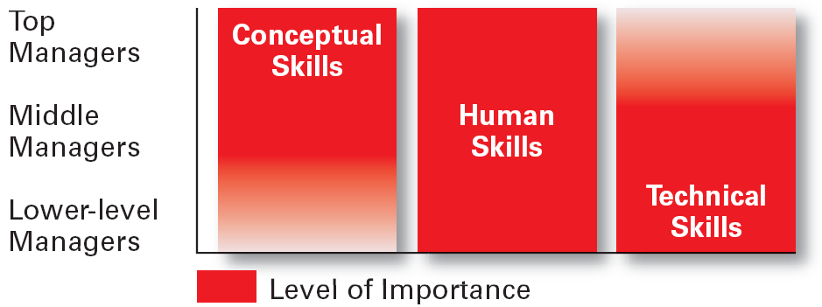
1–4 Skills Needed at Different
Management Levels
1–<number>

Slide 20
How The Manager’s Job Is Changing
The Increasing Importance of Customers
  Customers: the reason that organizations exist
    Managing customer relationships is the responsibility of all managers and employees.
    Consistent high quality customer service is essential for survival.
Innovation
  Doing things differently, exploring new challenges, and taking risks
    Managers should encourage employees to be aware of and act on opportunities for innovation.
1–<number>

Slide 21
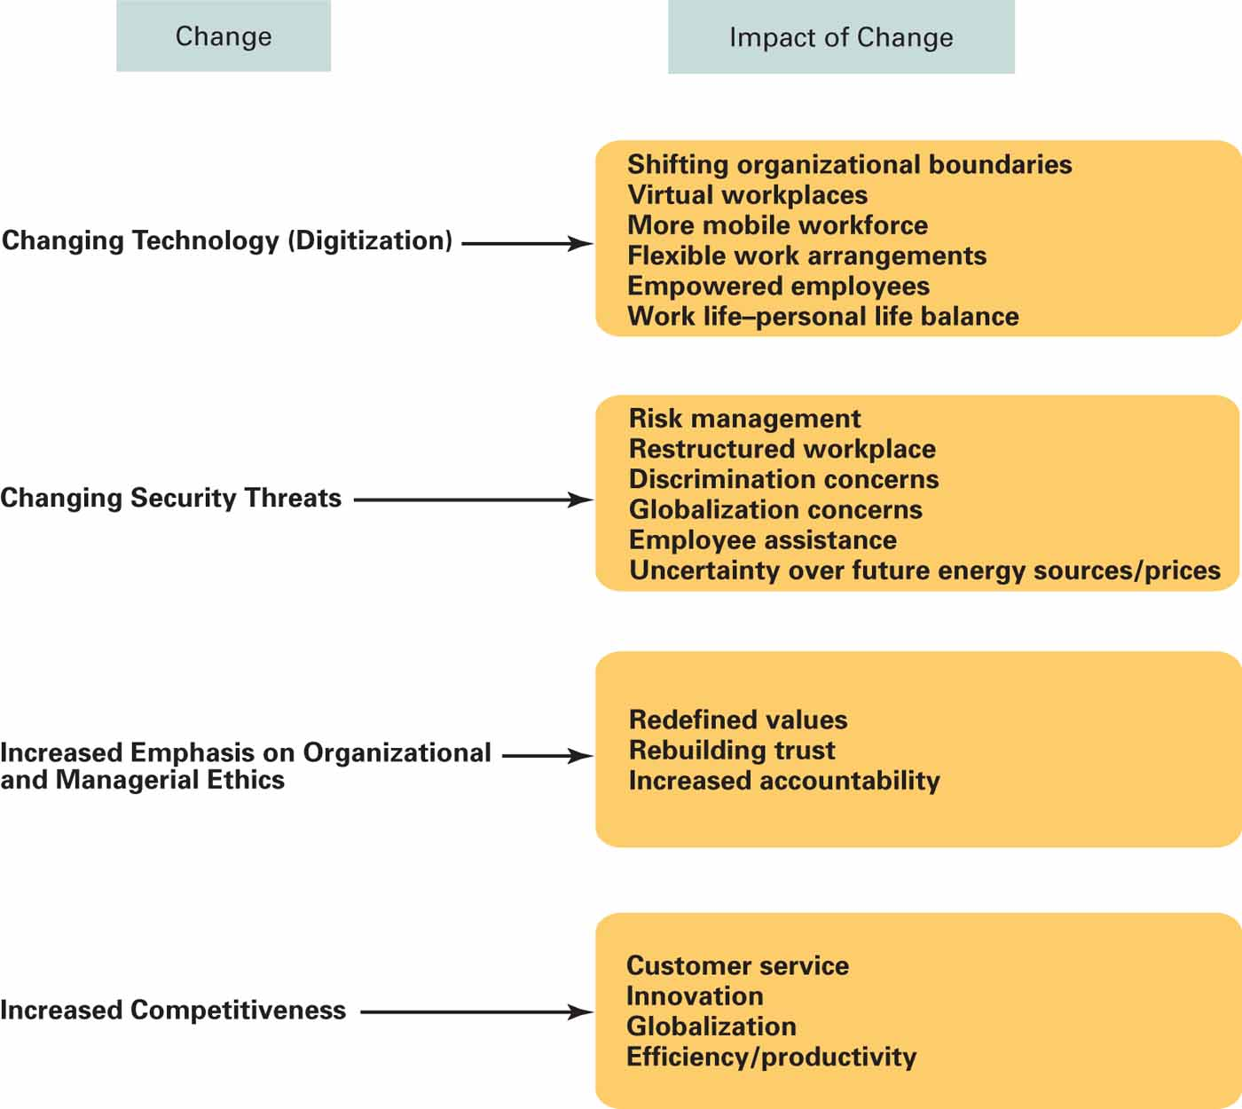
1–5
Changes Affecting a Manager’s Job
1–<number>

Slide 22
What Is An Organization?
An Organization Defined
  An arrangement of people to accomplish some specific purpose (that individuals independently could not accomplish alone).
Common Characteristics of Organizations
  Have a distinct purpose (goal)
  Composed of people
  Have a deliberate structure
1–<number>

Slide 23
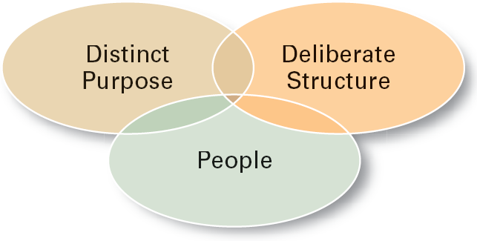
1–9 Characteristics of Organizations
1–<number>

Slide 24
Why Study Management?
The Value of Studying Management
  The universality of management
    Good management is needed in all organizations.
  The reality of work
    Employees either manage or are managed.
  Rewards and challenges of being a manager
    Management offers challenging, exciting and creative opportunities for meaningful and fulfilling work.
    Successful managers receive significant rewards for their efforts.
1–<number>

Slide 25
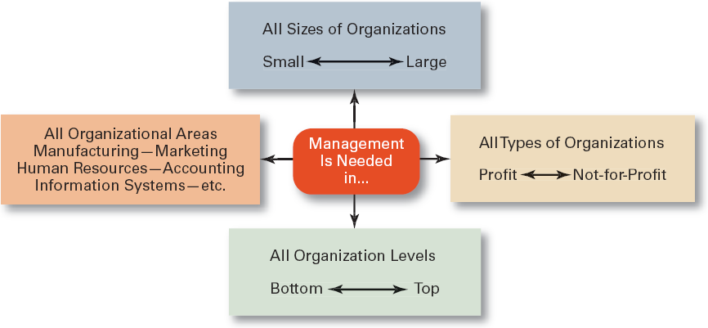
1–6 Universal Need for Management
1–<number>

